Slide 1
Chapter 4: SQL
Basic Structure
Set Operations
Aggregate Functions
Null Values
Nested Subqueries
Derived Relations
Views
Modification of the Database
Joined Relations
Data Definition Language
Embedded SQL, ODBC and JDBC
Notes:
1

Slide 2
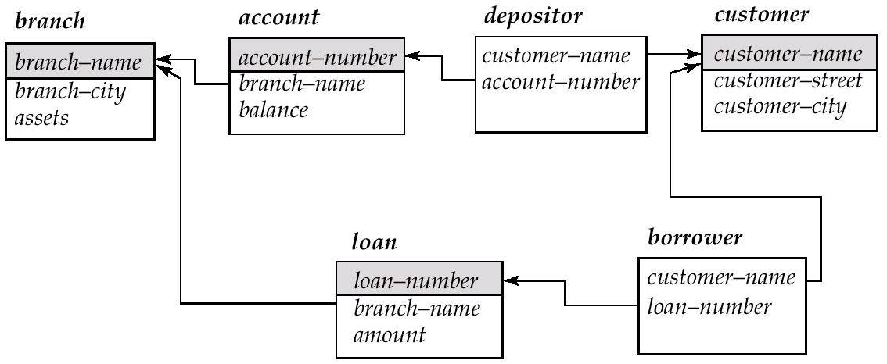
Schema Used in Examples

Slide 3
Basic Structure
SQL is based on set and relational operations with certain modifications and enhancements
A typical SQL query has the form: select A₁, A₂, ..., A_{n} from r₁, r₂, ..., r_{m} where P
A_{i}s represent attributes
r_{i}s represent relations
P is a predicate.
This query is equivalent to the relational algebra expression.
∏_{A1, A2, ..., An}(σ_{P} (r₁ x r₂ x ... x r_{m}))
The result of an SQL query is a relation.
Notes:
2

Slide 4
The select Clause
The select clause corresponds to the projection operation of the relational algebra. It is used to list the attributes desired in the result of a query.
Find the names of all branches in the loan relation select branch-name from loan
In the “pure” relational algebra syntax, the query would be:
∏_{branch-name}(loan)
An asterisk in the select clause denotes “all attributes”
select * from loan
NOTE: SQL does not permit the ‘-’ character in names, so you would use, for example, branch_name instead of branch-name in a real implementation. We use ‘-’ since it looks nicer!
NOTE: SQL names are case insensitive, meaning you can use upper case or lower case.
You may wish to use upper case in places where we use bold font.
Notes:
3

Slide 5
The select Clause (Cont.)
SQL allows duplicates in relations as well as in query results.
To force the elimination of duplicates, insert the keyword distinct after select. Find the names of all branches in the loan relations, and remove duplicates
select distinct branch-name from loan
The keyword all specifies that duplicates not be removed.
select all branch-name from loan
Notes:
4

Slide 6
The select Clause (Cont.)
The select clause can contain arithmetic expressions involving the operation, +, –, ∗, and /, and operating on constants or attributes of tuples.
The query:
select loan-number, branch-name, amount ∗ 100 from loan
would return a relation which is the same as the loan relations, except that the attribute amount is multiplied by 100.
Notes:
5

Slide 7
The where Clause
The where clause corresponds to the selection predicate of the relational algebra. If consists of a predicate involving attributes of the relations that appear in the from clause.
The find all loan number for loans made a the Perryridge branch with loan amounts greater than $1200. select loan-number from loan where branch-name = ‘Perryridge’ and amount > 1200
Comparison results can be combined using the logical connectives and, or, and not.
Comparisons can be applied to results of arithmetic expressions.
Notes:
6

Slide 8
The where Clause (Cont.)
SQL Includes a between comparison operator in order to simplify where clauses that specify that a value be less than or equal to some value and greater than or equal to some other value.
Find the loan number of those loans with loan amounts between $90,000 and $100,000 (that is, ≥$90,000 and ≤$100,000) select loan-number from loan where amount between 90000 and 100000
Notes:
7

Slide 9
The from Clause
The from clause corresponds to the Cartesian product operation of the relational algebra. It lists the relations to be scanned in the evaluation of the expression.
Find the Cartesian product borrower x loan select ∗ from borrower, loan
Find the name, loan number and loan amount of all customers having a loan at the Perryridge branch. select customer-name, borrower.loan-number, amount from borrower, loan where borrower.loan-number = loan.loan-number and branch-name = ‘Perryridge’
Notes:
8

Slide 10
The Rename Operation
The SQL allows renaming relations and attributes using the as clause: old-name as new-name
Find the name, loan number and loan amount of all customers; rename the column name loan-number as loan-id. select customer-name, borrower.loan-number as loan-id, amount from borrower, loan where borrower.loan-number = loan.loan-number
Notes:
9

Slide 11
Tuple Variables
Tuple variables are defined in the from clause via the use of the as clause.
Find the customer names and their loan numbers for all customers having a loan at some branch.
select customer-name, T.loan-number, S.amount from borrower as T, loan as S where T.loan-number = S.loan-number
Find the names of all branches that have greater assets than some branch located in Brooklyn. select distinct T.branch-name from branch as T, branch as S where T.assets > S.assets and S.branch-city = ‘Brooklyn’
Notes:
10

Slide 12
String Operations
SQL includes a string-matching operator for comparisons on character strings. Patterns are described using two special characters:
percent (%). The % character matches any substring.
underscore (_). The _ character matches any character.
Find the names of all customers whose street includes the substring “Main”.
select customer-name from customer where customer-street like ‘%Main%’
Match the name “Main%”
like ‘Main\%’ escape ‘\’
SQL supports a variety of string operations such as
concatenation (using “||”)
converting from upper to lower case (and vice versa)
finding string length, extracting substrings, etc.

Slide 13
Ordering the Display of Tuples
List in alphabetic order the names of all customers having a loan in Perryridge branch
select distinct customer-name from borrower, loan where borrower loan-number - loan.loan-number and branch-name = ‘Perryridge’ order by customer-name
We may specify desc for descending order or asc for ascending order, for each attribute; ascending order is the default.
E.g. order by customer-name desc

Slide 14
Duplicates
In relations with duplicates, SQL can define how many copies of tuples appear in the result.
Multiset versions of some of the relational algebra operators – given multiset relations r₁ and r₂:
1. If there are c₁ copies of tuple t₁ in r₁, and t₁ satisfies selections σ_{θ,}, then there are c₁ copies of t₁ in σ_{θ} (r₁).
2. For each copy of tuple t₁ in r₁, there is a copy of tuple Π_{A}(t₁) in Π_{A}(r₁) where Π_{A}(t₁) denotes the projection of the single tuple t₁.
3. If there are c₁ copies of tuple t₁ in r₁ and c₂ copies of tuple t₂ in r₂, there are c₁ x c₂ copies of the tuple t₁. t₂ in r₁ x r₂

Slide 15
Duplicates (Cont.)
Example: Suppose multiset relations r₁ (A, B) and r₂ (C) are as follows:
r₁ = {(1, a) (2,a)} r₂ = {(2), (3), (3)}
Then Π_{B}(r₁) would be {(a), (a)}, while Π_{B}(r₁) x r₂ would be
{(a,2), (a,2), (a,3), (a,3), (a,3), (a,3)}
SQL duplicate semantics:
select A₁,, A₂, ..., A_{n} from r₁, r₂, ..., r_{m} where P
is equivalent to the multiset version of the expression:
Π _{A1,, A2, ..., An}(σ_{P} (r₁ x r₂ x ... x r_{m}))

Slide 16
Set Operations
The set operations union, intersect, and except operate on relations and correspond to the relational algebra operations ∪, ∩, −.
Each of the above operations automatically eliminates duplicates; to retain all duplicates use the corresponding multiset versions union all, intersect all and except all. Suppose a tuple occurs m times in r and n times in s, then, it occurs:
m + n times in r union all s
min(m,n) times in r intersect all s
max(0, m – n) times in r except all s

Slide 17
Set Operations
Find all customers who have a loan, an account, or both:
(select customer-name from depositor) union (select customer-name from borrower)
Find all customers who have both a loan and an account.
(select customer-name from depositor) intersect (select customer-name from borrower)
Find all customers who have an account but no loan.
(select customer-name from depositor) except (select customer-name from borrower)

Slide 18
Aggregate Functions
These functions operate on the multiset of values of a column of a relation, and return a value
avg: average value min: minimum value max: maximum value sum: sum of values count: number of values

Slide 19
Aggregate Functions (Cont.)
Find the average account balance at the Perryridge branch.
select avg (balance) from account where branch-name = ‘Perryridge’
Find the number of tuples in the customer relation.
select count (*) from customer
Find the number of depositors in the bank.
select count (distinct customer-name) from depositor

Slide 20
Aggregate Functions – Group By
Find the number of depositors for each branch.
select branch-name, count (distinct customer-name) from depositor, account where depositor.account-number = account.account-number group by branch-name
Note: Attributes in select clause outside of aggregate functions must appear in group by list

Slide 21
Aggregate Functions – Having Clause
Find the names of all branches where the average account balance is more than $1,200.
select branch-name, avg (balance) from account group by branch-name having avg (balance) > 1200
Note: predicates in the having clause are applied after the formation of groups whereas predicates in the where clause are applied before forming groups

Slide 22
Null Values
It is possible for tuples to have a null value, denoted by null, for some of their attributes
null signifies an unknown value or that a value does not exist.
The predicate is null can be used to check for null values.
E.g. Find all loan number which appear in the loan relation with null values for amount.
select loan-number from loan where amount is null
The result of any arithmetic expression involving null is null
E.g. 5 + null returns null
However, aggregate functions simply ignore nulls
more on this shortly

Slide 23
Null Values and Three Valued Logic
Any comparison with null returns unknown
E.g. 5 < null or null <> null or null = null
Three-valued logic using the truth value unknown:
OR: (unknown or true) = true, (unknown or false) = unknown (unknown or unknown) = unknown
AND: (true and unknown) = unknown, (false and unknown) = false, (unknown and unknown) = unknown
NOT: (not unknown) = unknown
“P is unknown” evaluates to true if predicate P evaluates to unknown
Result of where clause predicate is treated as false if it evaluates to unknown

Slide 24
Null Values and Aggregates
Total all loan amounts
select sum (amount) from loan
Above statement ignores null amounts
result is null if there is no non-null amount, that is the
All aggregate operations except count(*) ignore tuples with null values on the aggregated attributes.

Slide 25
Nested Subqueries
SQL provides a mechanism for the nesting of subqueries.
A subquery is a select-from-where expression that is nested within another query.
A common use of subqueries is to perform tests for set membership, set comparisons, and set cardinality.

Slide 26
Example Query
Find all customers who have both an account and a loan at the bank.
select distinct customer-name from borrower where customer-name in (select customer-name from depositor)
Find all customers who have a loan at the bank but do not have an account at the bank
select distinct customer-name from borrower where customer-name not in (select customer-name from depositor)

Slide 27
Example Query
Find all customers who have both an account and a loan at the Perryridge branch
select distinct customer-name from borrower, loan where borrower.loan-number = loan.loan-number and branch-name = “Perryridge” and (branch-name, customer-name) in (select branch-name, customer-name from depositor, account where depositor.account-number = account.account-number)
Note: Above query can be written in a much simpler manner. The formulation above is simply to illustrate SQL features.
(Schema used in this example)

Slide 28
Set Comparison
Find all branches that have greater assets than some branch located in Brooklyn.
select distinct T.branch-name from branch as T, branch as S where T.assets > S.assets and S.branch-city = ‘Brooklyn’
Same query using > some clause
select branch-name from branch where assets > some (select assets from branch where branch-city = ‘Brooklyn’)

Slide 29
Definition of Some Clause
F <comp> some r ⇔ ∃ t ∈ r s.t. (F <comp> t) Where <comp> can be: <, ≤, >, =, ≠
0
(5< some
5
) = true
(read: 5 < some tuple in the relation)
6
0
(5< some
5
) = false
0
(5 = some
) = true
5
0
(5 ≠ some
5
) = true (since 0 ≠ 5)
(= some) ≡ in
However, (≠ some) ≡ not in

Slide 30
Definition of all Clause
F <comp> all r ⇔ ∀ t ∈ r (F <comp> t)
0
(5< all
) = false
5
6
6
(5< all
) = true
10
4
(5 = all
) = false
5
4
(5 ≠ all
) = true (since 5 ≠ 4 and 5 ≠ 6)
6
(≠ all) ≡ not in
However, (= all) ≡ in

Slide 31
Example Query
Find the names of all branches that have greater assets than all branches located in Brooklyn.
select branch-name from branch where assets > all (select assets from branch where branch-city = ‘Brooklyn’)

Slide 32
Test for Empty Relations
The exists construct returns the value true if the argument subquery is nonempty.
exists r ⇔ r ≠ Ø
not exists r ⇔ r = Ø

Slide 33
Example Query
Find all customers who have an account at all branches located in Brooklyn.
select distinct S.customer-name from depositor as S where not exists ( (select branch-name from branch where branch-city = ‘Brooklyn’) except (select R.branch-name from depositor as T, account as R where T.account-number = R.account-number and S.customer-name = T.customer-name))
(Schema used in this example)
Note that X – Y = Ø ⇔ X ⊆ Y
Note: Cannot write this query using = all and its variants

Slide 34
Test for Absence of Duplicate Tuples
The unique construct tests whether a subquery has any duplicate tuples in its result.
Find all customers who have at most one account at the Perryridge branch.
select T.customer-name
from depositor as T
where unique (
select R.customer-name from account, depositor as R where T.customer-name = R.customer-name and R.account-number = account.account-number and account.branch-name = ‘Perryridge’)
(Schema used in this example)

Slide 35
Example Query
Find all customers who have at least two accounts at the Perryridge branch.
select distinct T.customer-name
from depositor T
where not unique (
select R.customer-name
from account, depositor as R
where T.customer-name = R.customer-name and
R.account-number = account.account-number and
account.branch-name = ‘Perryridge’)
(Schema used in this example)

Slide 36
Views
Provide a mechanism to hide certain data from the view of certain users. To create a view we use the command:
create view v as <query expression>
where:
<query expression> is any legal expression
The view name is represented by v

Slide 37
Example Queries
A view consisting of branches and their customers
create view all-customer as (select branch-name, customer-name from depositor, account where depositor.account-number = account.account-number)
union (select branch-name, customer-name from borrower, loan where borrower.loan-number = loan.loan-number)
Find all customers of the Perryridge branch
select customer-name from all-customer where branch-name = ‘Perryridge’

Slide 38
Derived Relations
Find the average account balance of those branches where the average account balance is greater than $1200.
select branch-name, avg-balance from (select branch-name, avg (balance) from account group by branch-name) as result (branch-name, avg-balance) where avg-balance > 1200
Note that we do not need to use the having clause, since we compute the temporary (view) relation result in the from clause, and the attributes of result can be used directly in the where clause.

Slide 39
With Clause
With clause allows views to be defined locally to a query, rather than globally. Analogous to procedures in a programming language.
Find all accounts with the maximum balance with max-balance(value) as select max (balance) from account select account-number from account, max-balance where account.balance = max-balance.value

Slide 40
Complex Query using With Clause
Find all branches where the total account deposit is greater than the average of the total account deposits at all branches with branch-total (branch-name, value) as select branch-name, sum (balance) from account group by branch-name with branch-total-avg(value) as select avg (value) from branch-total select branch-name from branch-total, branch-total-avg where branch-total.value >= branch-total-avg.value

Slide 41
Modification of the Database – Deletion
Delete all account records at the Perryridge branch
delete from account where branch-name = ‘Perryridge’
Delete all accounts at every branch located in Needham city.
delete from account where branch-name in (select branch-name from branch where branch-city = ‘Needham’) delete from depositor where account-number in (select account-number from branch, account where branch-city = ‘Needham’ and branch.branch-name = account.branch-name)
(Schema used in this example)

Slide 42
Example Query
Delete the record of all accounts with balances below the average at the bank.
delete from account where balance < (select avg (balance) from account)
Problem: as we delete tuples from deposit, the average balance changes
Solution used in SQL:
1. First, compute avg balance and find all tuples to delete
2. Next, delete all tuples found above (without recomputing avg or retesting the tuples)

Slide 43
Modification of the Database – Insertion
Add a new tuple to account
insert into account values (‘A-9732’, ‘Perryridge’,1200) or equivalently insert into account (branch-name, balance, account-number) values (‘Perryridge’, 1200, ‘A-9732’)
Add a new tuple to account with balance set to null
insert into account values (‘A-777’,‘Perryridge’, null)

Slide 44
Modification of the Database – Insertion
Provide as a gift for all loan customers of the Perryridge branch, a $200 savings account. Let the loan number serve as the account number for the new savings account
insert into account select loan-number, branch-name, 200 from loan where branch-name = ‘Perryridge’ insert into depositor select customer-name, loan-number from loan, borrower where branch-name = ‘Perryridge’ and loan.account-number = borrower.account-number
The select from where statement is fully evaluated before any of its results are inserted into the relation (otherwise queries like insert into table1 select * from table1 would cause problems

Slide 45
Modification of the Database – Updates
Increase all accounts with balances over $10,000 by 6%, all other accounts receive 5%.
Write two update statements:
update account set balance = balance ∗ 1.06 where balance > 10000
update account set balance = balance ∗ 1.05 where balance ≤ 10000
The order is important
Can be done better using the case statement (next slide)

Slide 46
Case Statement for Conditional Updates
Same query as before: Increase all accounts with balances over $10,000 by 6%, all other accounts receive 5%.
update account set balance = case when balance <= 10000 then balance *1.05 else balance * 1.06 end

Slide 47
Update of a View
Create a view of all loan data in loan relation, hiding the amount attribute
create view branch-loan as select branch-name, loan-number from loan
Add a new tuple to branch-loan
insert into branch-loan values (‘Perryridge’, ‘L-307’)
This insertion must be represented by the insertion of the tuple
(‘L-307’, ‘Perryridge’, null)
into the loan relation
Updates on more complex views are difficult or impossible to translate, and hence are disallowed.
Most SQL implementations allow updates only on simple views (without aggregates) defined on a single relation

Slide 48
Transactions
A transaction is a sequence of queries and update statements executed as a single unit
Transactions are started implicitly and terminated by one of
commit work: makes all updates of the transaction permanent in the database
rollback work: undoes all updates performed by the transaction.
Motivating example
Transfer of money from one account to another involves two steps:
deduct from one account and credit to another
If one steps succeeds and the other fails, database is in an inconsistent state
Therefore, either both steps should succeed or neither should
If any step of a transaction fails, all work done by the transaction can be undone by rollback work.
Rollback of incomplete transactions is done automatically, in case of system failures

Slide 49
Transactions (Cont.)
In most database systems, each SQL statement that executes successfully is automatically committed.
Each transaction would then consist of only a single statement
Automatic commit can usually be turned off, allowing multi-statement transactions, but how to do so depends on the database system
Another option in SQL:1999: enclose statements within begin atomic … end

Slide 50
Joined Relations
Join operations take two relations and return as a result another relation.
These additional operations are typically used as subquery expressions in the from clause
Join condition – defines which tuples in the two relations match, and what attributes are present in the result of the join.
Join type – defines how tuples in each relation that do not match any tuple in the other relation (based on the join condition) are treated.
Join Types
Join Conditions
inner join
left outer join
right outer join
full outer join
natural
on <predicate>
using (A₁, A₂, ..., A_{n})

Slide 51
Joined Relations – Datasets for Examples
Relation loan
loan-number
branch-name
amount
L-170
L-230
L-260
Downtown
Redwood
Perryridge
3000
4000
1700
Relation borrower
customer-name
loan-number
Jones
Smith
Hayes
L-170
L-230
L-155
Note: borrower information missing for L-260 and loan information missing for L-155

Slide 52
Joined Relations – Examples
loan inner join borrower on loan.loan-number = borrower.loan-number
loan-number
branch-name
amount
customer-name
loan-number
L-170
L-230
Downtown
Redwood
3000
4000
Jones
Smith
L-170
L-230
loan left inner join borrower on loan.loan-number = borrower.loan-number
loan-number
branch-name
amount
customer-name
loan-number
L-170
L-230
L-260
Downtown
Redwood
Perryridge
3000
4000
1700
Jones
Smith
null
L-170
L-230
null

Slide 53
Joined Relations – Examples
loan natural inner join borrower
loan-number
branch-name
amount
customer-name
L-170
L-230
Downtown
Redwood
3000
4000
Jones
Smith
loan natural right outer join borrower
loan-number
branch-name
amount
customer-name
L-170
L-230
L-155
Downtown
Redwood
null
3000
4000
null
Jones
Smith
Hayes

Slide 54
Joined Relations – Examples
loan full outer join borrower using (loan-number)
loan-number
branch-name
amount
customer-name
L-170
L-230
L-260
L-155
Downtown
Redwood
Perryridge
null
3000
4000
1700
null
Jones
Smith
null
Hayes
Find all customers who have either an account or a loan (but not
both) at the bank. select customer-name from (depositor natural full outer join borrower) where account-number is null or loan-number is null

Slide 55
Data Definition Language (DDL)
Allows the specification of not only a set of relations but also information about each relation, including:
The schema for each relation.
The domain of values associated with each attribute.
Integrity constraints
The set of indices to be maintained for each relations.
Security and authorization information for each relation.
The physical storage structure of each relation on disk.

Slide 56
Domain Types in SQL
char(n). Fixed length character string, with user-specified length n.
varchar(n). Variable length character strings, with user-specified maximum length n.
int. Integer (a finite subset of the integers that is machine-dependent).
smallint. Small integer (a machine-dependent subset of the integer domain type).
numeric(p,d). Fixed point number, with user-specified precision of p digits, with n digits to the right of decimal point.
real, double precision. Floating point and double-precision floating point numbers, with machine-dependent precision.
float(n). Floating point number, with user-specified precision of at least n digits.
Null values are allowed in all the domain types. Declaring an attribute to be not null prohibits null values for that attribute.
create domain construct in SQL-92 creates user-defined domain types
create domain person-name char(20) not null

Slide 57
Date/Time Types in SQL (Cont.)
date. Dates, containing a (4 digit) year, month and date
E.g. date ‘2001-7-27’
time. Time of day, in hours, minutes and seconds.
E.g. time ’09:00:30’ time ’09:00:30.75’
timestamp: date plus time of day
E.g. timestamp ‘2001-7-27 09:00:30.75’
Interval: period of time
E.g. Interval ‘1’ day
Subtracting a date/time/timestamp value from another gives an interval value
Interval values can be added to date/time/timestamp values
Can extract values of individual fields from date/time/timestamp
E.g. extract (year from r.starttime)
Can cast string types to date/time/timestamp
E.g. cast <string-valued-expression> as date

Slide 58
Create Table Construct
An SQL relation is defined using the create table command:
create table r (A₁ D₁, A₂ D₂, ..., A_{n} D_{n}, (integrity-constraint₁), ..., (integrity-constraint_{k}))
r is the name of the relation
each A_{i} is an attribute name in the schema of relation r
D_{i} is the data type of values in the domain of attribute A_{i}
Example:
create table branch (branch-name char(15) not null, branch-city char(30), assets integer)

Slide 59
Integrity Constraints in Create Table
not null
primary key (A₁, ..., A_{n})
check (P), where P is a predicate
Example: Declare branch-name as the primary key for branch and ensure that the values of assets are non-negative.
create table branch (branch-name char(15), branch-city char(30) assets integer, primary key (branch-name), check (assets >= 0))
primary key declaration on an attribute automatically ensures not null in SQL-92 onwards, needs to be explicitly stated in SQL-89

Slide 60
Drop and Alter Table Constructs
The drop table command deletes all information about the dropped relation from the database.
The after table command is used to add attributes to an existing relation. All tuples in the relation are assigned null as the value for the new attribute. The form of the alter table command is
alter table r add A D
where A is the name of the attribute to be added to relation r and D is the domain of A.
The alter table command can also be used to drop attributes of a relation alter table r drop A where A is the name of an attribute of relation r
Dropping of attributes not supported by many databases

Slide 61
Embedded SQL
The SQL standard defines embeddings of SQL in a variety of programming languages such as Pascal, PL/I, Fortran, C, and Cobol.
A language to which SQL queries are embedded is referred to as a host language, and the SQL structures permitted in the host language comprise embedded SQL.
The basic form of these languages follows that of the System R embedding of SQL into PL/I.
EXEC SQL statement is used to identify embedded SQL request to the preprocessor
EXEC SQL <embedded SQL statement > END-EXEC
Note: this varies by language. E.g. the Java embedding uses # SQL { …. } ;

Slide 62
Example Query
From within a host language, find the names and cities of customers with more than the variable amount dollars in some account.
Specify the query in SQL and declare a cursor for it
EXEC SQL
declare c cursor for select customer-name, customer-city from depositor, customer, account where depositor.customer-name = customer.customer-name and depositor account-number = account.account-number and account.balance > :amount
END-EXEC

Slide 63
Embedded SQL (Cont.)
The open statement causes the query to be evaluated
EXEC SQL open c END-EXEC
The fetch statement causes the values of one tuple in the query result to be placed on host language variables.
EXEC SQL fetch c into :cn, :cc END-EXEC Repeated calls to fetch get successive tuples in the query result
A variable called SQLSTATE in the SQL communication area (SQLCA) gets set to ‘02000’ to indicate no more data is available
The close statement causes the database system to delete the temporary relation that holds the result of the query.
EXEC SQL close c END-EXEC
Note: above details vary with language. E.g. the Java embedding defines Java iterators to step through result tuples.

Slide 64
Updates Through Cursors
Can update tuples fetched by cursor by declaring that the cursor is for update
declare c cursor for select * from account where branch-name = ‘Perryridge’ for update
To update tuple at the current location of cursor
update account set balance = balance + 100 where current of c

Slide 65
Dynamic SQL
Allows programs to construct and submit SQL queries at run time.
Example of the use of dynamic SQL from within a C program. char * sqlprog = “update account set balance = balance * 1.05 where account-number = ?” EXEC SQL prepare dynprog from :sqlprog; char account [10] = “A-101”; EXEC SQL execute dynprog using :account;
The dynamic SQL program contains a ?, which is a place holder for a value that is provided when the SQL program is executed.

Slide 66
ODBC
Open DataBase Connectivity(ODBC) standard
standard for application program to communicate with a database server.
application program interface (API) to
open a connection with a database,
send queries and updates,
get back results.
Applications such as GUI, spreadsheets, etc. can use ODBC

Slide 67
ODBC (Cont.)
Each database system supporting ODBC provides a "driver" library that must be linked with the client program.
When client program makes an ODBC API call, the code in the library communicates with the server to carry out the requested action, and fetch results.
ODBC program first allocates an SQL environment, then a database connection handle.
Opens database connection using SQLConnect(). Parameters for SQLConnect:
connection handle,
the server to which to connect
the user identifier,
password
Must also specify types of arguments:
SQL_NTS denotes previous argument is a null-terminated string.

Slide 68
ODBC Code
int ODBCexample()
{
RETCODE error;
HENV env; /* environment */
HDBC conn; /* database connection */
SQLAllocEnv(&env);
SQLAllocConnect(env, &conn);
SQLConnect(conn, "aura.bell-labs.com", SQL_NTS, "avi", SQL_NTS, "avipasswd", SQL_NTS);
{ …. Do actual work … }
SQLDisconnect(conn);
SQLFreeConnect(conn);
SQLFreeEnv(env);
}

Slide 69
ODBC Code (Cont.)
Program sends SQL commands to the database by using SQLExecDirect
Result tuples are fetched using SQLFetch()
SQLBindCol() binds C language variables to attributes of the query result
When a tuple is fetched, its attribute values are automatically stored in corresponding C variables.
Arguments to SQLBindCol()
ODBC stmt variable, attribute position in query result
The type conversion from SQL to C.
The address of the variable.
For variable-length types like character arrays,
The maximum length of the variable
Location to store actual length when a tuple is fetched.
Note: A negative value returned for the length field indicates null value
Good programming requires checking results of every function call for errors; we have omitted most checks for brevity.

Slide 70
ODBC Code (Cont.)
Main body of program
char branchname[80]; float balance; int lenOut1, lenOut2; HSTMT stmt;
SQLAllocStmt(conn, &stmt); char * sqlquery = "select branch_name, sum (balance) from account group by branch_name";
error = SQLExecDirect(stmt, sqlquery, SQL_NTS);
if (error == SQL_SUCCESS) { SQLBindCol(stmt, 1, SQL_C_CHAR, branchname , 80, &lenOut1); SQLBindCol(stmt, 2, SQL_C_FLOAT, &balance, 0 , &lenOut2);
while (SQLFetch(stmt) >= SQL_SUCCESS) { printf (" %s %g\n", branchname, balance); } } SQLFreeStmt(stmt, SQL_DROP);

Slide 71
More ODBC Features
Prepared Statement
SQL statement prepared: compiled at the database
Can have placeholders: E.g. insert into account values(?,?,?)
Repeatedly executed with actual values for the placeholders
Metadata features
finding all the relations in the database and
finding the names and types of columns of a query result or a relation in the database.
By default, each SQL statement is treated as a separate transaction that is committed automatically.
Can turn off automatic commit on a connection
SQLSetConnectOption(conn, SQL_AUTOCOMMIT, 0)}
transactions must then be committed or rolled back explicitly by
SQLTransact(conn, SQL_COMMIT) or
SQLTransact(conn, SQL_ROLLBACK)

Slide 72
ODBC Conformance Levels
Conformance levels specify subsets of the functionality defined by the standard.
Core
Level 1 requires support for metadata querying
Level 2 requires ability to send and retrieve arrays of parameter values and more detailed catalog information.
SQL Call Level Interface (CLI) standard similar to ODBC interface, but with some minor differences.

Slide 73
JDBC
JDBC is a Java API for communicating with database systems supporting SQL
JDBC supports a variety of features for querying and updating data, and for retrieving query results
JDBC also supports metadata retrieval, such as querying about relations present in the database and the names and types of relation attributes
Model for communicating with the database:
Open a connection
Create a “statement” object
Execute queries using the Statement object to send queries and fetch results
Exception mechanism to handle errors

Slide 74
JDBC Code
public static void JDBCexample(String dbid, String userid, String passwd)
{
try {
Class.forName ("oracle.jdbc.driver.OracleDriver");
Connection conn = DriverManager.getConnection( "jdbc:oracle:thin:@aura.bell-labs.com:2000:bankdb", userid, passwd);
Statement stmt = conn.createStatement();
… Do Actual Work ….
stmt.close();
conn.close();
}
catch (SQLException sqle) {
System.out.println("SQLException : " + sqle);
}
}

Slide 75
JDBC Code (Cont.)
Update to database
try {
stmt.executeUpdate( "insert into account values ('A-9732', 'Perryridge', 1200)");
} catch (SQLException sqle) {
System.out.println("Could not insert tuple. " + sqle);
}
Execute query and fetch and print results
ResultSet rset = stmt.executeQuery( "select branch_name, avg(balance) from account group by branch_name");
while (rset.next()) {
System.out.println( rset.getString("branch_name") + " " + rset.getFloat(2));
}

Slide 76
JDBC Code Details
Getting result fields:
rs.getString(“branchname”) and rs.getString(1) equivalent if branchname is the first argument of select result.
Dealing with Null values
int a = rs.getInt(“a”);
if (rs.wasNull()) Systems.out.println(“Got null value”);

Slide 77
Prepared Statement
Prepared statement allows queries to be compiled and executed multiple times with different arguments
PreparedStatement pStmt = conn.prepareStatement(
“insert into account values(?,?,?)”); pStmt.setString(1, "A-9732");
pStmt.setString(2, "Perryridge");
pStmt.setInt(3, 1200);
pStmt.executeUpdate();
pStmt.setString(1, "A-9733");
pStmt.executeUpdate();
NOTE: If value to be stored in database contains a single quote or other special character, prepared statements work fine, but creating a string and executing it directly would result in a syntax error!

Slide 78
Other SQL Features
SQL sessions
client connects to an SQL server, establishing a session
executes a series of statements
disconnects the session
can commit or rollback the work carried out in the session
An SQL environment contains several components, including a user identifier, and a schema, which identifies which of several schemas a session is using.

Slide 79
Schemas, Catalogs, and Environments
Three-level hierarchy for naming relations.
Database contains multiple catalogs
each catalog can contain multiple schemas
SQL objects such as relations and views are contained within a schema
e.g. catalog5.bank-schema.account
Each user has a default catalog and schema, and the combination is unique to the user.
Default catalog and schema are set up for a connection
Catalog and schema can be omitted, defaults are assumed
Multiple versions of an application (e.g. production and test) can run under separate schemas

Slide 80
Procedural Extensions and Stored Procedures
SQL provides a module language
permits definition of procedures in SQL, with if-then-else statements, for and while loops, etc.
more in Chapter 9
Stored Procedures
Can store procedures in the database
then execute them using the call statement
permit external applications to operate on the database without knowing about internal details
These features are covered in Chapter 9 (Object Relational Databases)

Slide 81
Extra Material on JDBC and Application Architectures

Slide 82
Transactions in JDBC

Slide 83
Procedure and Function Calls in JDBC
JDBC provides a class CallableStatement which allows SQL stored procedures/functions to be invoked.
CallableStatement cs1 = conn.prepareCall( “{call proc (?,?)}” ) ;
CallableStatement cs2 = conn.prepareCall( “{? = call func (?,?)}” );

Slide 84
Result Set MetaData
The class ResultSetMetaData provides information about all the columns of the ResultSet.
Instance of this class is obtained by getMetaData( ) function of ResultSet.
Provides Functions for getting number of columns, column name, type, precision, scale, table from which the column is derived etc.
ResultSetMetaData rsmd = rs.getMetaData ( );
for ( int i = 1; i <= rsmd.getColumnCount( ); i++ ) {
String name = rsmd.getColumnName(i);
String typeName = rsmd.getColumnTypeName(i); }

Slide 85
Database Meta Data
The class DatabaseMetaData provides information about database relations
Has functions for getting all tables, all columns of the table, primary keys etc.
E.g. to print column names and types of a relation
DatabaseMetaData dbmd = conn.getMetaData( );
ResultSet rs = dbmd.getColumns( null, “BANK-DB”, “account”, “%” ); //Arguments: catalog, schema-pattern, table-pattern, column-pattern // Returns: 1 row for each column, with several attributes such as // COLUMN_NAME, TYPE_NAME, etc.
while ( rs.next( ) ) { System.out.println( rs.getString(“COLUMN_NAME”) , rs.getString(“TYPE_NAME”); }
There are also functions for getting information such as
Foreign key references in the schema
Database limits like maximum row size, maximum no. of connections, etc

Slide 86
Application Architectures
Applications can be built using one of two architectures
Two tier model
Application program running at user site directly uses JDBC/ODBC to communicate with the database
Three tier model
Users/programs running at user sites communicate with an application server. The application server in turn communicates with the database

Slide 87
Two-tier Model
E.g. Java code runs at client site and uses JDBC to communicate with the backend server
Benefits:
flexible, need not be restricted to predefined queries
Problems:
Security: passwords available at client site, all database operation possible
More code shipped to client
Not appropriate across organizations, or in large ones like universities

Slide 88
Three Tier Model
CGI Program
Application/HTTP
Server
JDBC
Database
Server
Servlets
HTTP/Application Specific Protocol
Network
Client
Client
Client

Slide 89
Three-tier Model (Cont.)
E.g. Web client + Java Servlet using JDBC to talk with database server
Client sends request over http or application-specific protocol
Application or Web server receives request
Request handled by CGI program or servlets
Security handled by application at server
Better security
Fine granularity security
Simple client, but only packaged transactions

Slide 90
End of Chapter

Slide 91
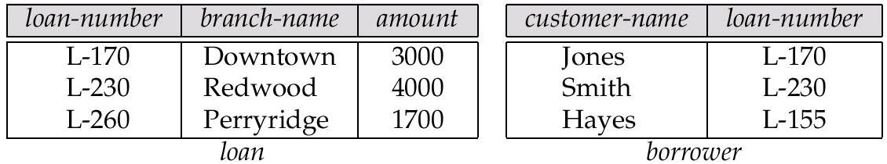
The loan and borrower Relations

Slide 92
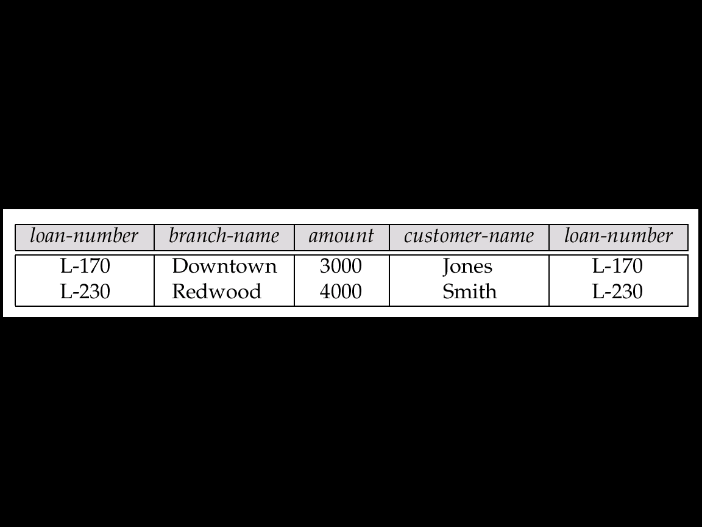
The Result of loan inner join borrower on loan.loan-number = borrower.loan-number

Slide 93
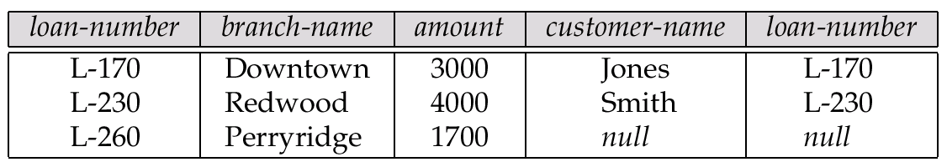
The Result of loan left outer join borrower on loan-number

Slide 94
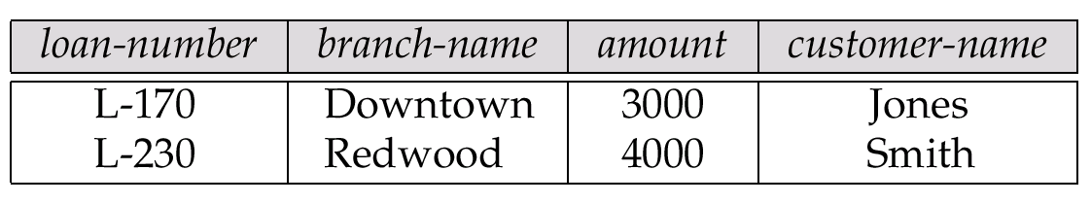
The Result of loan natural inner join borrower

Slide 95
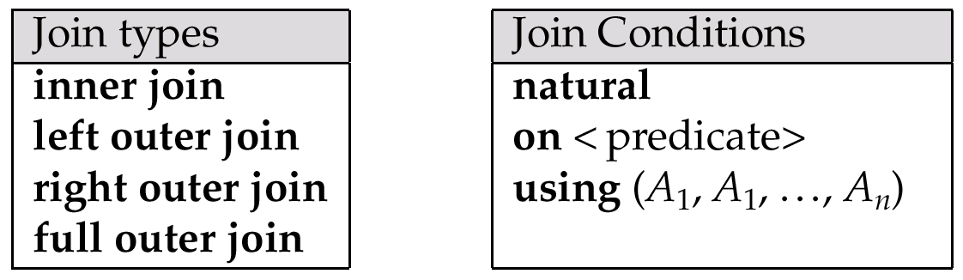
Join Types and Join Conditions

Slide 96
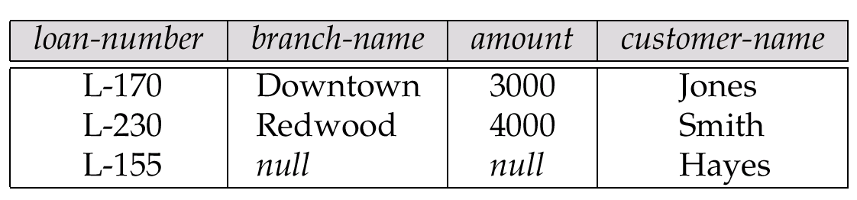
The Result of loan natural right outer join borrower

Slide 97
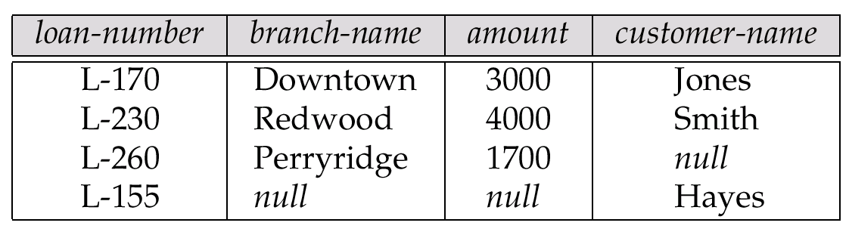
The Result of loan full outer join borrower using(loan-number)

Slide 98
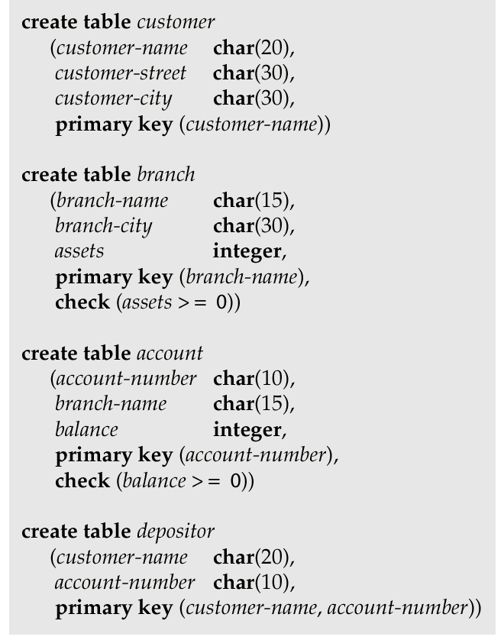
SQL Data Definition for Part of the Bank Database

